Slide 1
Python code
1
2
3
4
5
Extract named entities and semantic roles
Identify persons quoted by name
Perform dependency parsing
Identify titles of persons
Combine results across documents
Names and titles of executives
Press Releases
Watson Natural Language Understanding
Python libraries
Text Extensions for Pandas
SpaCy
Text Extensions for Pandas

Slide 2
Cloud service
Watson Natural Language Understanding
Names and titles of executives
Python code
Extract named entities and semantic roles
Identify persons quoted by name
Identify regions to parse
Perform targeted dependency parsing
Extract titles of persons
Combine results across documents
Press Releases
Python libraries
Text Extensions for Pandas
Text Extensions for Pandas
SpaCy
Text Extensions for Pandas

Slide 3
Watson Natural Language Understanding
Cloud service has a rate limit. 5 requests/sec while testing on Lite tier.
80 requests/sec while running on Standard tier.
Exceed rate limit and requests will fail.
Names and titles of executives
Extract named entities and semantic roles
Identify persons quoted by name
Identify regions to parse
Perform targeted dependency parsing
Extract titles of persons
Combine results across documents
Press Releases
Text Extensions for Pandas
Text Extensions for Pandas
SpaCy
Text Extensions for Pandas
Large and expensive deep learning model.

Slide 4
Watson Natural Language Understanding
Names and titles of executives
Actor pool
Actor
Extract named entities and semantic roles
Identify persons quoted by name
Identify regions to parse
Perform targeted dependency parsing
Extract titles of persons
Combine results across documents
Press Releases
Text Extensions for Pandas
Text Extensions for Pandas
SpaCy
Text Extensions for Pandas

Slide 5
Watson Natural Language Understanding
Multithreaded actor performs client-side request throttling.
Names and titles of executives
Actor pool
Actor
Extract named entities and semantic roles
Identify persons quoted by name
Identify regions to parse
Perform targeted dependency parsing
Extract titles of persons
Combine results across documents
Actor pool amortizes model startup costs and parallelizes model inference.
Press Releases
Text Extensions for Pandas
Text Extensions for Pandas
SpaCy
Text Extensions for Pandas

Slide 6
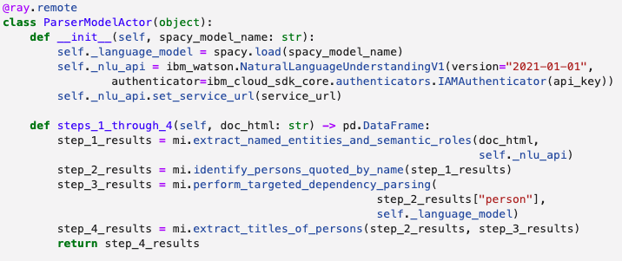
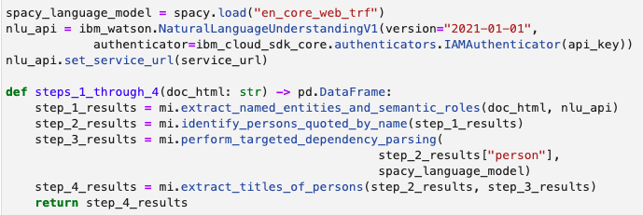

Slide 7
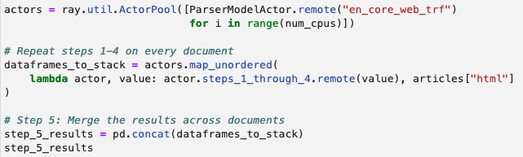
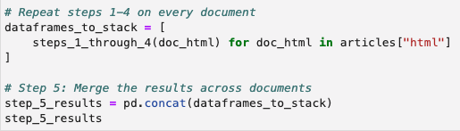

Slide 9
IBM's recent investment in technology, assets, resources and skills development with HBCUs across the United States through the IBM Skills Academy and enhanced IBM Academic Initiative.
"Equal access to skills and jobs is the key to unlocking economic opportunity and prosperity for diverse populations," said Valinda Scarbro Kennedy, HBCU Program Lead, IBM Global University Programs. "As we announced earlier this fall, IBM is deeply committed to helping HBCU students build their skills to better prepare for the future of work. Through this collaboration, Harris-Stowe

Slide 10
IBM's recent investment in technology, assets, resources and skills development with HBCUs across the United States through the IBM Skills Academy and enhanced IBM Academic Initiative.
"Equal access to skills and jobs is the key to unlocking economic opportunity and prosperity for diverse populations," said Valinda Scarbro Kennedy, HBCU Program Lead, IBM Global University Programs. "As we announced earlier this fall, IBM is deeply committed to helping HBCU students build their skills to better prepare for the future of work. Through this collaboration, Harris-Stowe
Executive quote
Name of executive

Slide 11
IBM's recent investment in technology, assets, resources and skills development with HBCUs across the United States through the IBM Skills Academy and enhanced IBM Academic Initiative.
"Equal access to skills and jobs is the key to unlocking economic opportunity and prosperity for diverse populations," said Valinda Scarbro Kennedy, HBCU Program Lead, IBM Global University Programs. "As we announced earlier this fall, IBM is deeply committed to helping HBCU students build their skills to better prepare for the future of work. Through this collaboration, Harris-Stowe
Executive quote
Name of executive
Title of executive

Slide 12
Present Tense
"Equal access to skills and jobs is the key to unlocking economic opportunity and prosperity for diverse populations," says Valinda Scarbro Kennedy, HBCU Program Lead, IBM Global University Programs.
Attribution before quote
Valinda Scarbro Kennedy, HBCU Program Lead, IBM Global University Programs, said, "Equal access to skills and jobs is the key to unlocking economic opportunity and prosperity for diverse populations."
Attribution in middle
“Equal access to skills and jobs,” said Valinda Scarbro Kennedy, HBCU Program Lead, IBM Global University Programs, “is the key to unlocking economic opportunity and prosperity for diverse populations," said.

Slide 13
IBM's recent investment in technology, assets, resources and skills development with HBCUs across the United States through the IBM Skills Academy and enhanced IBM Academic Initiative.
"Equal access to skills and jobs is the key to unlocking economic opportunity and prosperity for diverse populations," said Valinda Scarbro Kennedy, HBCU Program Lead, IBM Global University Programs. "As we announced earlier this fall, IBM is deeply committed to helping HBCU students build their skills to better prepare for the future of work. Through this collaboration, Harris-Stowe

Slide 14
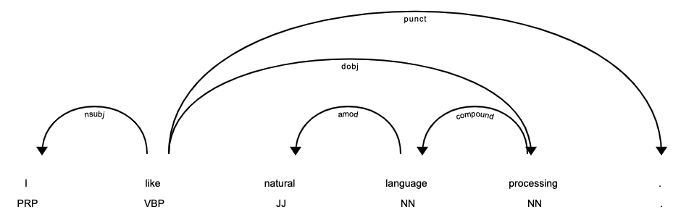
Words become nodes of the tree

Slide 15
Relationships between words become edges

Slide 16
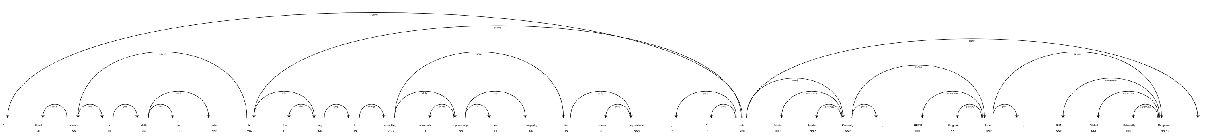

Slide 17
Relationships
between words
Name
Job Title

Slide 19
IBM has delivered over the past three to five years from the organization linkage between IBM Research and IBM products.
"By combining the power of AI with the flexibility and agility of hybrid cloud, our clients are driving innovation and digitizing their operations at a fast pace," said Daniel Hernandez, general manager, Data and AI, IBM. "The IDC MarketScape's recognition of IBM's Watson portfolio highlights the innovations of IBM Research powering our commercial AI offerings,

Slide 20
IBM has delivered over the past three to five years from the organization linkage between IBM Research and IBM products.
"By combining the power of AI with the flexibility and agility of hybrid cloud, our clients are driving innovation and digitizing their operations at a fast pace," said Daniel Hernandez, general manager, Data and AI, IBM. "The IDC MarketScape's recognition of IBM's Watson portfolio highlights the innovations of IBM Research powering our commercial AI offerings,
Executive quote
Name of executive

Slide 21
IBM has delivered over the past three to five years from the organization linkage between IBM Research and IBM products.
"By combining the power of AI with the flexibility and agility of hybrid cloud, our clients are driving innovation and digitizing their operations at a fast pace," said Daniel Hernandez, general manager, Data and AI, IBM. "The IDC MarketScape's recognition of IBM's Watson portfolio highlights the innovations of IBM Research powering our commercial AI offerings,
Executive quote
Name of executive
Title of executive

Slide 22
Present Tense
"By combining the power of AI with the flexibility and agility of hybrid cloud, our clients are driving innovation and digitizing their operations at a fast pace," says Daniel Hernandez, general manager, Data and AI, IBM.
Attribution before quote
Daniel Hernandez, general manager, Data and AI, IBM, said "By combining the power of AI with the flexibility and agility of hybrid cloud, our clients are driving innovation and digitizing their operations at a fast pace."
Attribution in middle
"By combining the power of AI with the flexibility and agility of hybrid cloud,” said Daniel Hernandez, general manager, Data and AI, IBM, “our clients are driving innovation and digitizing their operations at a fast pace."

Slide 24
Daniel Hernandez
General manager, Data and AI, IBM

Slide 25
Edge between name and job title
Name
Job Title

Slide 26
Relationships
between words
Name
Job Title

